Slide 1



Code2Inv: A Deep Learning Framework for Program Verification
Xujie Si, Aaditya Naik, Mayur Naik
Hanjun Dai
Le Song

Slide 2
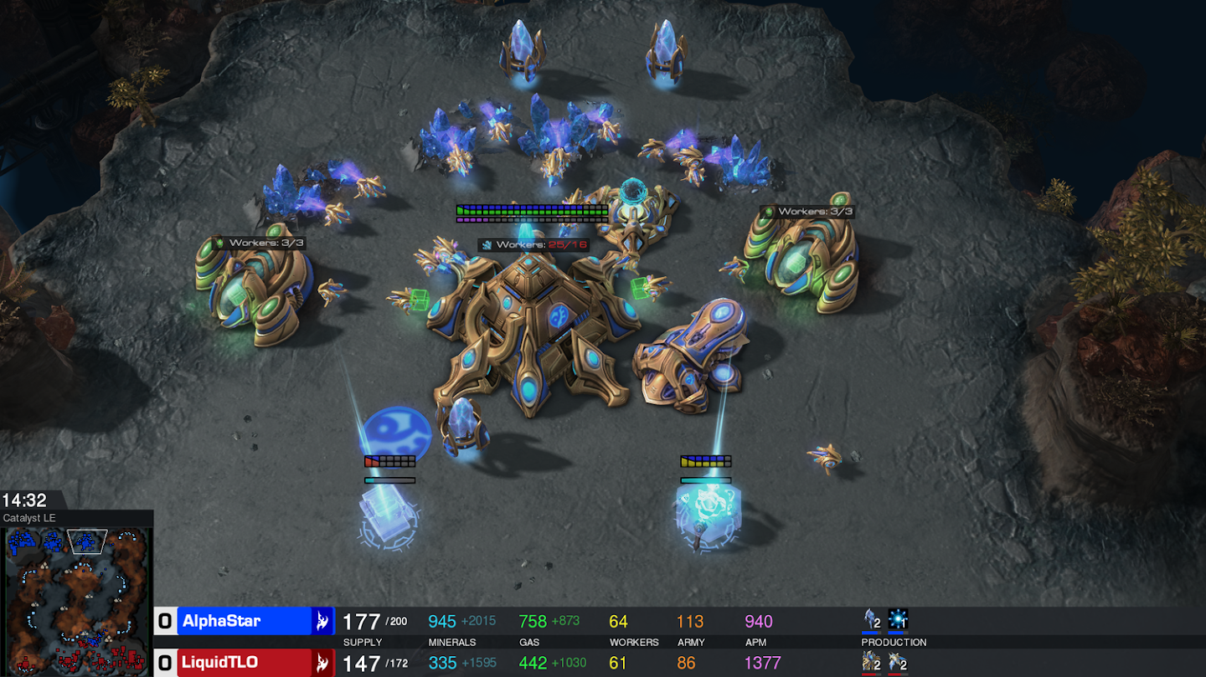
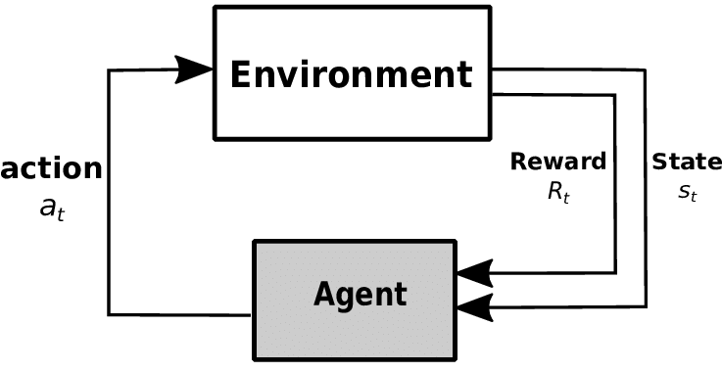
Inspiring Successes of Reinforcement Learning
Strategy Game Playing
Mention
Rules
checker
Rules specifying valid moves / actions
Environment giving scores or judging the outcome
Program Verification
Program Verification
grammar
checker
Grammar (i.e. production rules) specifying the syntax of proofs
Checker validating the correctness
Notes:
TODO: Use nicer figure for reinforcement learning diagram. Keywords: Agent, Action, Evironment, Interpreter, Reward, State.

Slide 3
From Games to Programs: New Challenges
 | Representation Learning |  | Reinforcement Learning
 | State | Neural Nets | Action | Reward
Games | 2-D raw pixels (size is fixed) | ConvNet ResNet | Fixed & Finite | Rich Self-plays
Programs | Structured data (size varies) | ? | Context-free grammar | Extremely sparse
Graph Neural Network
Counterexample-guided reward design (inspired by CEGIS)
Almost always zero!

Slide 4
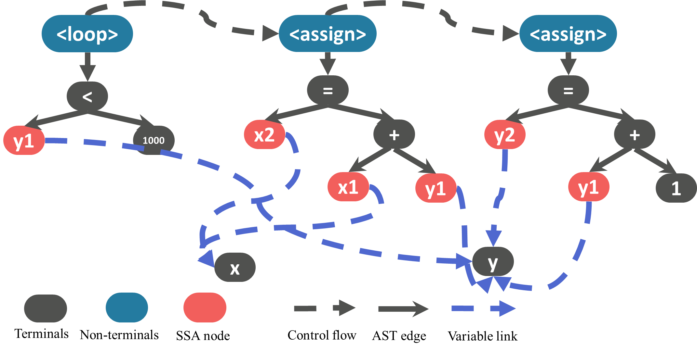
Overview of Code2Inv
Invariant Grammar
Grammar
CHC Predicate Grammar
Candidate
Solution
assume (x == 1 /\ y == 1)
while (y < 1000) {
x = x + y;
y = y + 1; } assert (x >= 1600)
New Tasks
Checker
CHC Proof Checker
Code2Inv
SMT Proof Checker
Constrained Horn Clauses
(CHC)
Counter-
Examples
C Source Code

Slide 5
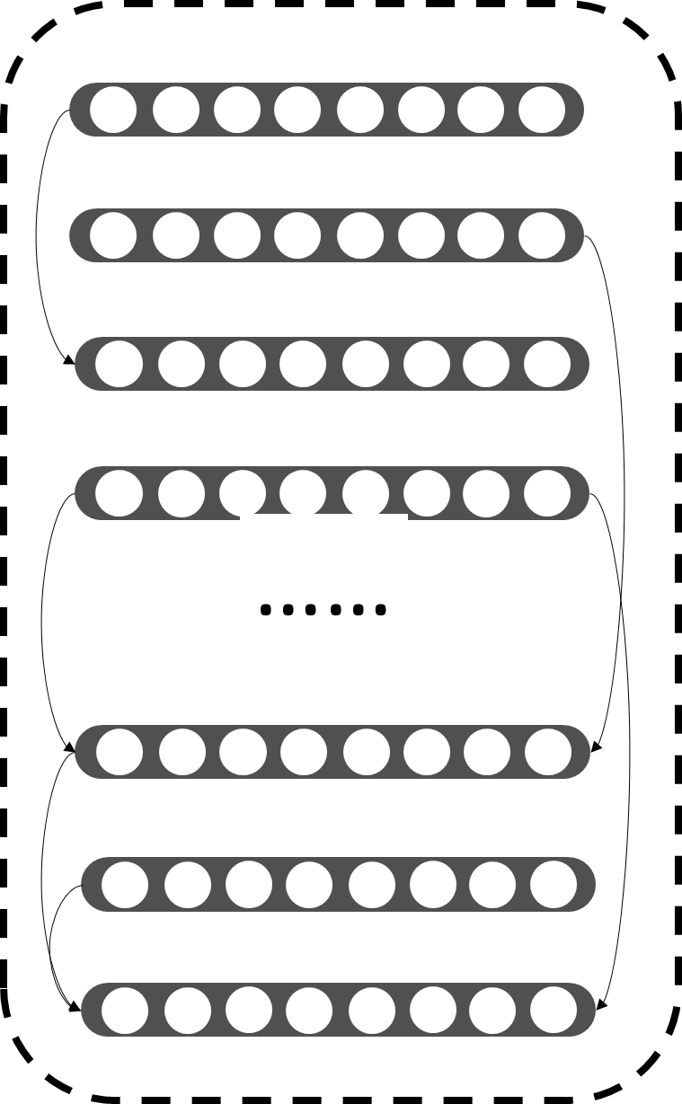
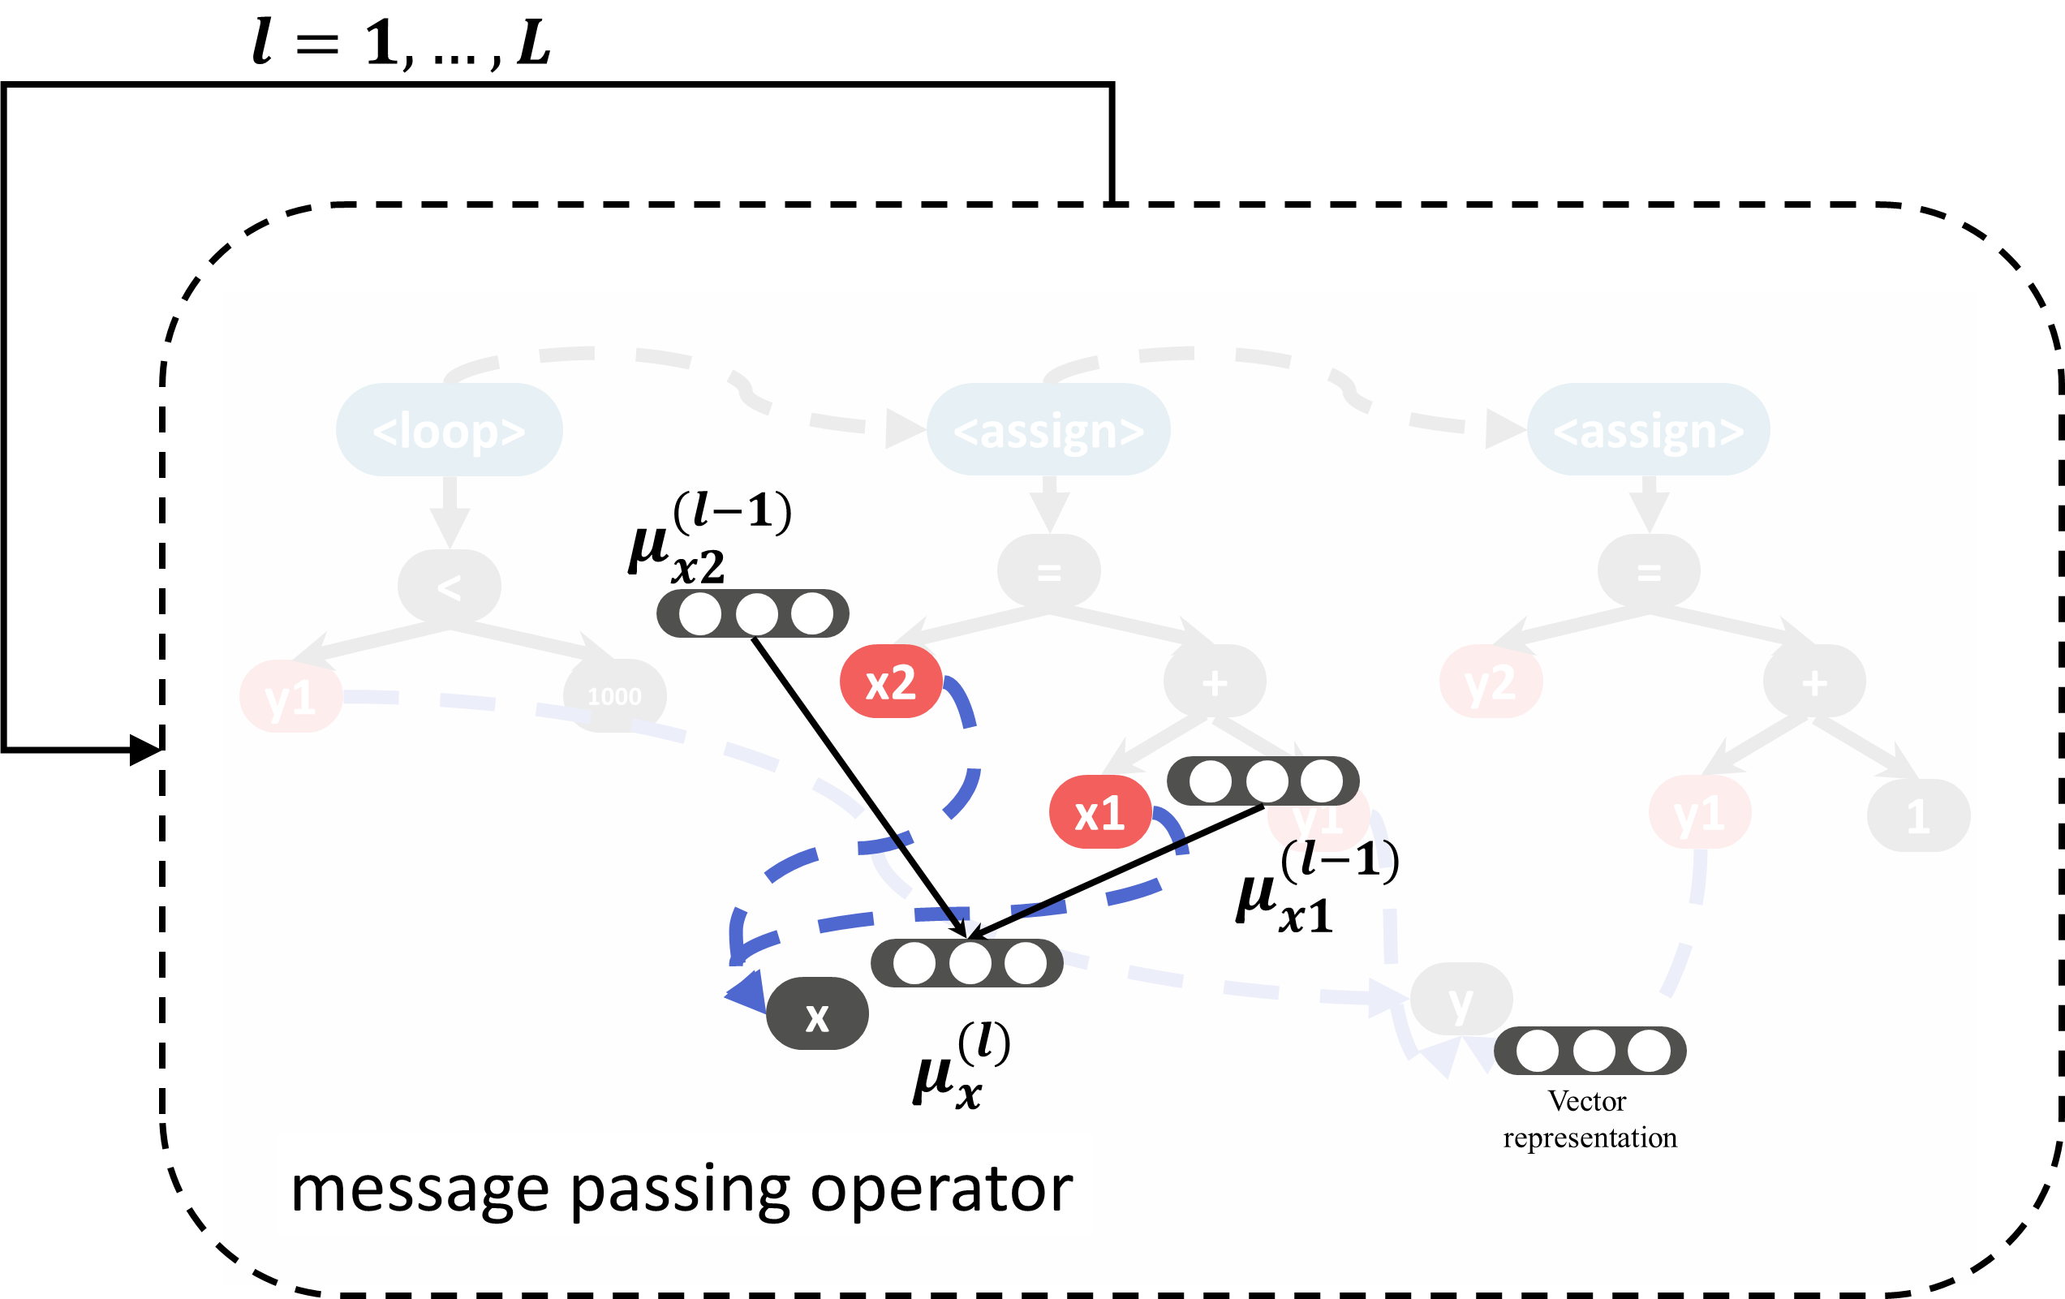
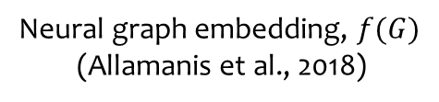
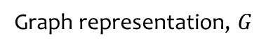
Representing Programs
Poor performance
Out-of-vocabulary issues
No structural information
Program
View a program as a sequence of characters or tokens
while (y < 1000) {
x = x + y
y = y + 1
}
Sequential models
Structured External Memory
(Graves et al., 2014)
Graph representation, $G$
Neural graph embedding, $f(G)$
(Allamanis et al., 2018)
Notes:
Sequence models do not work well
structurally similar programs should have similar embeddings;

Slide 6
Example Grammar
S ::= C | C and S
C ::= P | P or C
P ::= expr cmp expr
expr ::= expr op expr
| var
| const
cmp ::= < | > | == | <= | >=
op ::= + | -
Special grammar placeholders for program variables and constants
| *
Adding * to solve non-linear problems
S is the fixed starting rule for the grammar

Slide 7
Smoothed Reward
Candidate
Solution
success
Reinforcement Learning
Early
Reward
Checker
fail
Continuous
Reward
Counter-
Examples
Notes:
Jointly trained

Slide 8

Experimental Evaluation
Loop Invariant Synthesis
Solving CHC Constraints (case study)
133 C benchmark programs
127 CHC instances
Three state-of-the-art tools:
C2I: Stochastic search for desired invariant
ICE-DT: Decision tree learner using predicate templates
LoopInvGen: Boolean function learning using predicate abstraction
Two state-of-the-art solvers:
Spacer: the least-fixed point engine of Z3
DataDrivenCHC: Spacer guided by a decision tree learner and linear classifiers
Winners of 2016 and 2017 SyGuS competitions

Slide 9
Performance
Loop Invariant Synthesis
CHC Constraint Solving
DataDrivenCHC
(118)
Spacer
(112)
94
Code2Inv (99)
Code2Inv solved 5 NIA instances unsolved by the other tools
All tools run with single core CPU for up to 12 hours
Notes:
Code2Inv solves most instances
Makes an order-of-magnitude fewer queries to Z3 and considers fewer candidate invariants
Mention all solvers run on the same machine up to 6 hours
No training on verification cost

Slide 10
Case Study on Naturalness
Solution found by Spacer:
Solution found by DataDrivenCHC:
Solution found by Code2Inv:
Solution found by Code2Inv:
(<= B (- A B))
(or (< V0 (+ 0 0)) (> V1 V0))

Slide 11
Extending Code2Inv
Defines the syntax of the solution for the program
Grammar
Code2Inv
Program
Front-End
Representation Learning
Reinforcement Learning
Converts the program into a JSON graph representation
Counter-
Examples
Candidate
Solution
Checker
Checks the candidate solution and returns counter-examples if failed

Slide 12
Conclusion
End-to-end learning framework for program reasoning tasks
Automation: alleviates need to hand-engineer search heuristics
Flexibility: easily extensible to new domains
Adaptivity: adapt search strategies within and across instances
Naturality: produces more natural solutions

Slide 13

Try Code2Inv
www.code2inv.org
Source Code | Benchmarks | Demos

